Slide 1

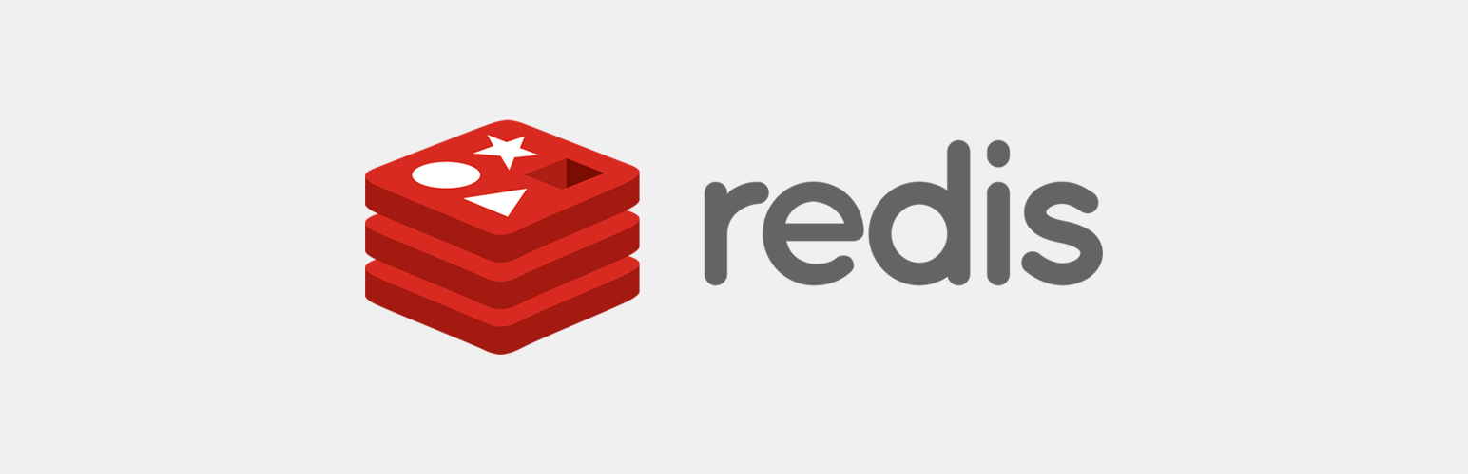
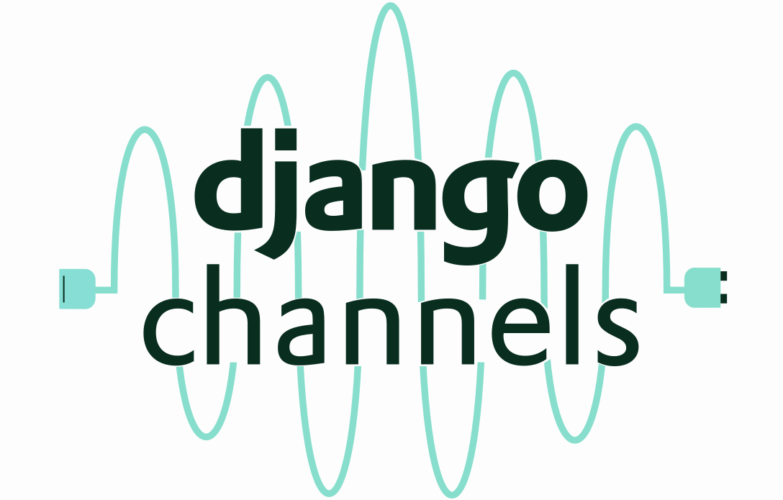
Websockets con Django Rest Framework
Pedro Miguel

Slide 2
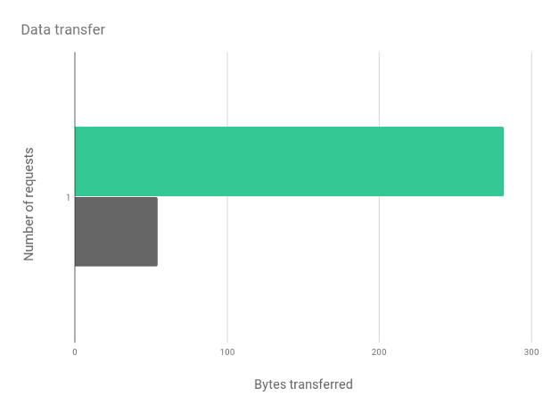
Problema
Solicitudes HTTP
SetInterval()
Memoria del cliente
Tiempo de respuesta del servidor

Slide 3
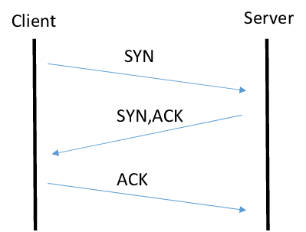
Websockets
RFC 6455
Intercambio de información asíncrona
TCP/IP Full Duplex
Uso frecuente: Notificaciones, chat.

Slide 4
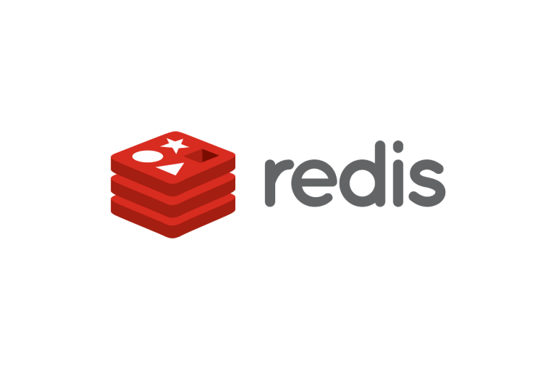
REDIS
Almacén de datos en memoria
AWS ElasticCache
Almacenamiento Caché
Chat
Multimedia
Machine Learning

Slide 5

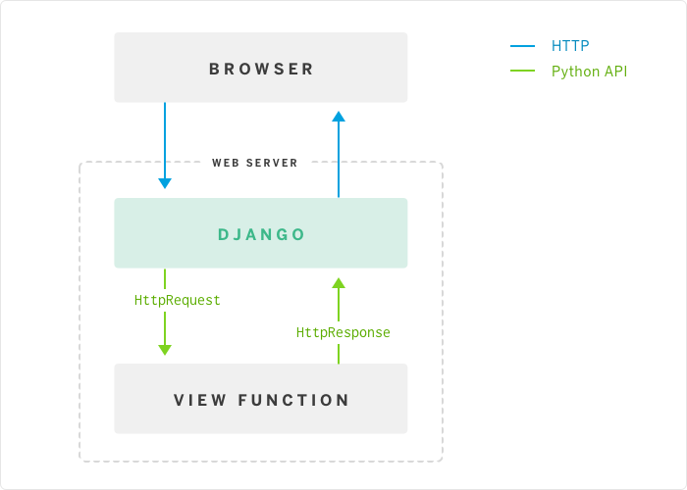
Django Channels
WSGI: Web Server Gateway Interface

Slide 6
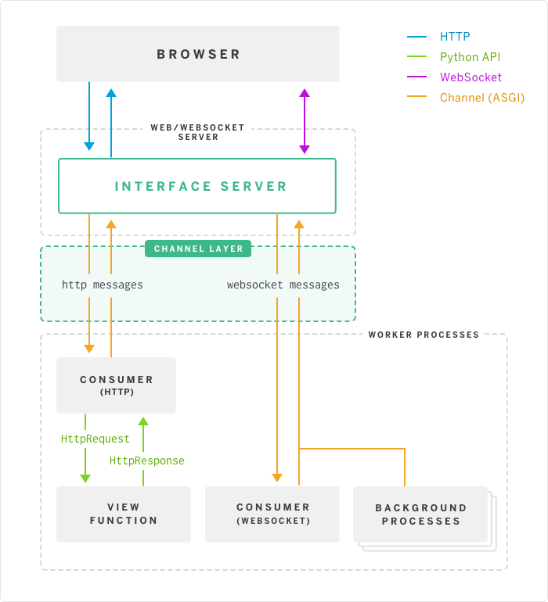
Django Channels
ASGI: Asynchronous Server Gateway Interface

Slide 7
Django Channels
Configuración ASGI
settings.py
- INSTALLED_APPS = [
...
'channels',
]
- ASGI_APPLICATION = 'demo_web.routing.application'
- CHANNEL_LAYERS = {
'default': {
'BACKEND': 'channels_redis.core.RedisChannelLayer',
'CONFIG': {
'hosts': [(REDIS_HOST, REDIS_PORT)],
},
},
}

Slide 8
Django Channels
Configuración Routing.py
from django.core.asgi import get_asgi_application
from django.urls import path
from channels.routing import ProtocolTypeRouter, URLRouter
from blog.consumers import PostConsumer #Consumer
application = ProtocolTypeRouter({
'http': get_asgi_application(),
'websocket': URLRouter([
path('posts/', PostConsumer.as_asgi()),
]),
})

Slide 9
Django Channels
Configuración Consumers.py
import asyncio
from channels.generic.websocket import AsyncJsonWebsocketConsumer
class PostConsumer(AsyncJsonWebsocketConsumer):
async def connect(self):
await self.accept()
await self.channel_layer.group_add('entries', self.channel_name)
async def disconnect(self, code):
await self.channel_layer.group_discard('entries', self.channel_name)

Slide 10
Happy Hacking

